Slide 1
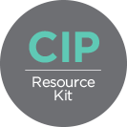


Costed Implementation Plan Resource Kit
Date:
Presented by:
Costed Implementation Plans for FP2020
Produced by:

Slide 2
Why Do a Costed Implementation Plan?
A CIP is a strategic multi-year planning document that details activities and costs for achieving our goals.
[Include here any pertinent goals and/or challenges a CIP will help address, e.g., contribution of FP to country’s development goals, country’s FP goals, FP2020 commitments, estimated number of women with unmet need, etc.]
“The CIP has helped us to determine budgetary needs to reposition our family planning efforts. Monitoring the CIP is helping us to be more strategic in how resources are invested in the country to get results…”
Maurice Hiza,
National Family Planning Coordinator, Government of Tanzania
www.familyplanning2020.org/cip
2
Notes:
Costed implementation plans for family planning are concrete plans for achieving the goals of a national FP program over a set number of years.
A CIP can help us meet our [refer to FP goals] and address [refer to challenge such as unmet need].
CIPs also detail the program activities necessary to meet national goals and the costs associated with the activities, providing clear program-level information on the resources a country must raise domestically and from partners.
The gap analysis can inform and support resource mobilization efforts.

Slide 3
A CIP promotes…
Strategic decision making to allocate limited resources
Realistic assessment and costing of program requirements
Coordination and alignment of donors and stakeholders behind the government’s priorities
www.familyplanning2020.org/cip
3
Notes:
Add any relevant quotes, photos, or other content.

Slide 4
Purpose of the CIP
Clarify a unified country strategy
Describe activities and outline an implementation roadmap in coordination with all partners
Estimate demographic, health, and economic impacts of FP investments
Develop a budget
Secure new commitments from partners based on defined needs and gaps
Monitor progress
www.familyplanning2020.org/cip
4
Notes:
Strong planning and funding for family planning ensure the greatest benefit to the health and rights of women, their families, communities, and the nation. Increasing access to family planning contributes to reducing maternal and child mortality, reducing poverty, and supporting countries to achieve the demographic dividend, which can enable sustainable economic development.
A CIP serves the following purposes:
1. Clarifies country strategies—The CIP articulates the country’s consensus-driven priorities for family planning. The consultative CIP becomes a social contract for donors and implementing partners. It helps ensure that all family planning activities are aligned with the country’s needs, prevents fragmentation of efforts, and guides current and new partners in their FP investments and programs.
2. Details activities and an implementation roadmap—The CIP ensures that all necessary activities are included with defined objectives and are appropriately sequenced in a roadmap to deliver the outcomes to reach the country’s FP2020 goals and any other commitments made. CIPs outline the roles and responsibilities of all the organizations involved in the FP program.
3. Estimates impact—Part of the CIP development process is to apply tools that estimate a range of impacts, including demographic impacts (unintended pregnancies averted, abortions averted); health impacts (maternal deaths averted, child deaths averted, unsafe abortions averted); and economic impacts (healthcare costs saved) of a fully implemented FP program.
4. Defines a budget—The CIP determines detailed costs associated with the entire family planning program (including commodity costs and program activities) between now and 2020, or another strategic date. The CIP budgeting tool can be re-applied as needed to adjust to changes in funding or program design.
5. Secures commitment—The CIP process determines and secures current donor and national government commitments, identifies funding gaps, and develops an advocacy plan to ensure adequate funding is raised.
6. Monitors progress—The CIP’s performance management mechanisms measure the extent of activity implementation and help ensure that the country’s FP program is meeting its objectives, ensuring coordination, and guiding any necessary course corrections.

Slide 5
CIPs Can Address All the Major Thematic Areas of FP Programming
Demand creation
Service delivery and access
Contraceptive security
Policy and enabling environment
Financing
Stewardship, management, and accountability
www.familyplanning2020.org/cip
5
Notes:
All components of an FP program can be addressed and budgeted for in the CIP:
- Demand creation
- Service delivery and access
- Contraceptive security (including commodity procurement and supply chain management)
- Policy and enabling environment (includes advocacy)
- Financing
- Stewardship, management, and accountability (including aspects of supervision, training, and monitoring and evaluation)

Slide 6

Countries with CIPs for FP
CIPs in response to FP2020 or Ouagadougou Partnership
Bangladesh
Benin
Burkina Faso
Cameroon
Côte d’Ivoire
Democratic Republic of the Congo
Guinea
Kenya
Mali
Mauritania
Niger
Nigeria (Federal & Gombe State)
Senegal
Tanzania
Togo
Uganda
Zambia
[Update with latest country information]
www.familyplanning2020.org/cip
6
Notes:
A number of countries have or are doing CIPs—either in response to their FP2020 commitments or the Ouagadougou Partnership goals from 2011 (reach an additional 1,000,000 women in the region with contraception by 2015).
As of the end of [2014], the following countries have developed CIPs:
Bangladesh, Benin, Burkina Faso, Cameroon, Côte d’Ivoire, Democratic Republic of the Congo, Guinea, Kenya, Mali, Mauritania, Niger, Nigeria (Federal & Gombe State), Senegal, Tanzania, Togo, Uganda, Zambia [Update the list and graphic with the latest country information, or if a map is unavailable, remove the graphic]

Slide 7
CIP Experiences and Results
Provide guidance for reaching FP goals
Promote greater action, accountability, advocacy
Support expanded services
“The CIP is a tool that will empower us in Kenya to confidently advocate for investments in FP for the Kenya Vision 2030 with accurate figures of cost and priorities. In fact, the CIP can be referred to as the “Bible” of family planning program implementation in Kenya…”
Dr. Bashir M. Isaac,
Former Director, Division of Reproductive Health, Kenya
Source: FHI 360, May 2013, Costed Implementation Plans: Guidance and Lessons Learned.
www.familyplanning2020.org/cip
7
Notes:
Supporting points for the bullets. These are just a few examples; you may want to research some other examples to include. Add details into the slide as needed.
CIPs provided guidance for reaching country level FP goals
In Kenya, the Division of Reproductive Health decided to do a CIP to help the country better meet FP demand by increasing the CPR to 56% by 2015, up from 46%
In Senegal, the government developed a CIP in preparation for making commitments to specific activities and to ask for resources at the 2012 London Summit
In Tanzania, stakeholders used the CIP to determine what funds were needed and could be mobilized to meet FP goals in existing plans
In Burkina Faso, the CIP will support the government’s ambitious Ouagadougou Partnership commitment of increasing its CPR to 25 percent by 2015, which will require an additional 332,000 new modern contraceptive users; fully implementing the CIP will provide access to modern contraceptives for an additional 399,000 women by 2015
CIPs promoted greater action, accountability, and advocacy
Additional staff hired in Zambia to support the FP program, including dedicated staff to monitor CIP implementation
New budget line item in Tanzania national budget for contraceptive commodities, and sharp increases in funding for family planning
Re-focused investments in Tanzania in underperforming regions
The Government of Zambia and advocates worked together to institute a separate RH commodity budget line item and allocated $9.3 million for fiscal year 2014 for RH supplies– advocates estimate this is double previous commitments
CIPs supported expanded services
Integration of new community-based services for injectables into broader program in Nigeria’s Gombe State
Development and roll-out of new sex education curricula for Zambian public schools

Slide 8
CIP Timeframe and Costs
Timeframe and costs will vary depending on the country and the scope of the CIP
A CIP may take 6 months to 1 year to develop through an inclusive, participatory process
CIPs usually cover 3 to 6 years; thus, implementation will last several years
Costs of developing a CIP are typically covered by a mix of domestic government and international donor resources
www.familyplanning2020.org/cip
8

Slide 9
CIP Products
National Action Plan for Family Planning
National FP situational analysis
Stakeholder engagement plan
Implementation framework with activity detail and timeline
Detailed activity-based budgets
Financial gap analysis
Estimates of impacts
Monitoring and evaluation tools
Resource mobilization framework
Optional products:
Regional activity plans and budgets
Marketing and communications materials
www.familyplanning2020.org/cip
9
Notes:
CIP products typically completed prior to plan launch:
A National Action Plan for Family Planning
A detailed list of activities to be implemented with a corresponding timeline
Detailed activity-based budgets
A financial gap analysis
Impact estimates of demographic, health, and economic impacts
A national landscape analysis for family planning
Monitoring and evaluation (M&E) tools
Optional products include:
Regional activity plans and budgets
Marketing and communications materials (e.g., brochures)

Slide 10
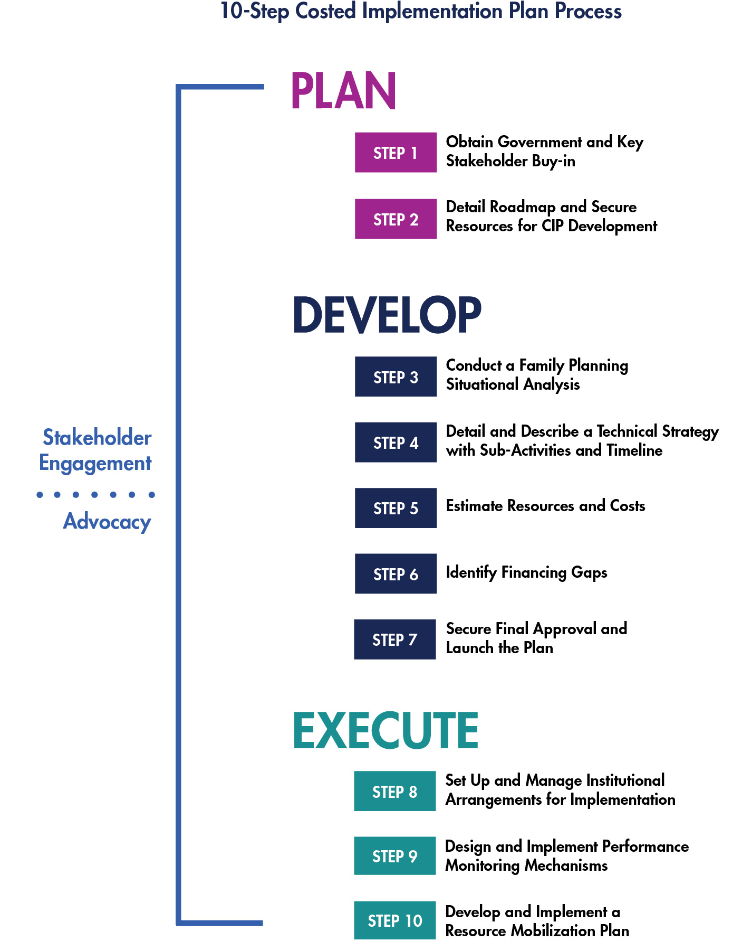
CIP 10-Step Process
10-step process established by the governments, donors, and partners experienced in CIP development and execution to date
Steps cover planning, development, and execution
Not every country will move through 10 steps or use all tools/templates in the CIP Resource Kit
Resources available as needed to support different goals, timeframes, and budgets
PG. 10
www.familyplanning2020.org/cip
10
Notes:
Based on the experiences of countries, partners, and donors that have been involved in CIP development thus far, a 10-step process has been developed to provide guidance and standards to those just beginning the CIP process, as well as common tools and processes for those already engaged in CIP development and implementation. The 10-step process is also meant to standardize plans and processes associated with CIP development as more and more countries develop costed strategic plans for family planning.

Slide 11
CIP 10-Step Process: Phase 1
www.familyplanning2020.org/cip
11
Notes:
The CIP approach presented here supports a country-led process for creating a plan that aligns with ongoing government planning and coordination efforts. The full 10-step process is implemented across three sequential phases: plan, develop, and execute.
I will now present a high-level overview of the full process. Note that not every country will necessarily move through all 10 steps.
Phase 1: Plan
Step1:Obtain government and key stakeholder buy-in
Sub-steps:
Arrive at the decision to engage in a CIP process
Make a formal request for CIP support
Form the CIP Task Force
Obtain commitment to providing human and financial resources for CIP development
Step 2. Detail roadmap for process and secure resources for CIP development
Sub-steps:
Form CIP Technical Support Team
Develop the process roadmap
Identify and engage stakeholders

Slide 12
CIP 10-Step Process: Phase 2
www.familyplanning2020.org/cip
12
Notes:
A 10-step approach supports a country-led process for creating a CIP that aligns with ongoing government planning and coordination efforts.
Phase 2: Develop
Step 3. Conduct a family planning situational analysis
Sub-steps
Gather information on the current FP context
Conduct information review, synthesis, and analysis
Prioritize issues and analyze root causes
Step 4. Detail and describe a technical strategy with sub-activities and timeline
Sub-steps
Develop a logical framework
Determine the activity timeline
Estimate goals
Define indicators
Refine and validate plan
Estimate impact
(optional) Align with the subnational level
Step 5. Estimate the resources required to achieve CIP objectives and associated costs
Sub-steps
Estimate common unit costs
Input the quantity of units required to achieve plan objectives
Complete the costing
Review the costing
6. Identify financing gaps
Sub-steps
Collect information on the projected funding for FP
Compare projected funding levels to the CIP resource requirements
Review the estimated funding gaps
Secure final approval and launch the CIP
Sub-steps
Review and approve the CIP
Develop a dissemination plan and materials
Produce and print the final CIP document
Hold a launch event

Slide 13
CIP 10-Step Process: Phase 3
www.familyplanning2020.org/cip
13
Notes:
A 10-step approach supports a country-led process for creating a CIP that aligns with ongoing government planning and coordination efforts.
Phase 3: Execute
Step 8. Set up and manage institutional arrangements for implementation
Organize an implementation coordination mechanism
Develop a subnational implementation plan
Identify capacity-building and implementation support needs
Develop annual joint workplans
Review and revise the CIP as a “living document”
9. Design and implement performance monitoring mechanisms
Develop a performance monitoring mechanism
Design data collection tools
Roll out the performance monitoring system
10. Develop and implement a resource mobilization plan
Develop and implement a resource mobilization plan to provide sustainable funding for CIP implementation
Conduct ongoing advocacy

Slide 14
Typical Resource Commitments for CIP Development
Ministry of Health commitments
1 staff to act as MOH Focal Point
1 staff to act as CIP Project Manager
Office space and basic administrative support for any in-country technical assistance
Partner/donor commitments
Program information and feedback throughout the process
Seconded staff for CIP process, part- or full-time
Support for other CIP costs at request of the government (e.g., national and/or regional consultative workshops, national consultants, etc.)
www.familyplanning2020.org/cip
14
Notes:
While the CIP development process will differ slightly from country to country, some typical resource commitments required to move the process along include the following:
Timeframe
Allow approximately one year to develop and launch the CIP
Ministry of Health commitment to provide
1 staff member to act as MOH Focal Point, dedicating approximately 50%–75% time
1 staff member to act as CIP Project Manager, dedicating 75–100% time. This role may also be filled by staff from an active implementing partner.
(Note that these estimates for level of effort for ministry staff are based on a six-month CIP development schedule; if the process is stretched out to one year, these staff members may need less concentrated, but sustained effort)
Office space for any in-country technical assistance support
Basic administrative support for any in-country technical assistance support (printing, assistance with organizing meetings by setting appointments and following up with partners, etc.).
Partner/donor commitment and engagement to help ensure that all of the relevant civil society organizations are involved in and committed to the collaborative process
Providing program information and feedback throughout the process
Seconding staff to participate in the CIP process, part- or full-time
Supporting other costs related to the CIP process upon request of the government (e.g., national and/or regional consultative workshops, national consultants, etc.)

Slide 15
Next Steps
[Add actions or decision points to move the process forward, e.g.,
Assess the MOH’s interest, needs, and resources
Discuss resource gaps with donors]
“Costed implementation plans are crucial for determining the financing gap and mobilizing resources. They are important for governments to determine the internal resources that have to be mobilized to fill the gap.”
Ishrat Husain,
Senior Health Adviser,
Africa Bureau, USAID
www.familyplanning2020.org/cip
15
Notes:
Add next steps specific to your context and timeframe.

Slide 16
Thank you.
The information provided in this document is not official U.S. Government information and does not necessarily represent the views or positions of the U.S. Agency for International Development.
Contact Us
Health Policy Project
1331 Pennsylvania Ave NW
Suite 600
Phone: (202) 775-9680
E-mail: policyinfo@futuresgroup.com
www.healthpolicyproject.com
The Health Policy Project is a five-year cooperative agreement funded by the U.S. Agency for International Development under Agreement No. AID-OAA-A-10-00067, beginning September 30, 2010. It is implemented by Futures Group, in collaboration with Plan International USA, Avenir Health (formerly Futures Institute), Partners in Population and Development, Africa Regional Office (PPD ARO), Population Reference Bureau (PRB), RTI International, and the White Ribbon Alliance for Safe Motherhood (WRA).

