Slide 1
Photo by Michael Tewelde

Slide 2
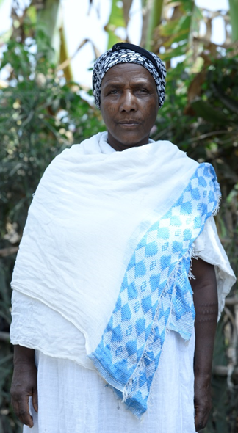
Meet Asegedech
Asegedech married Abebe at the age of 16.
They had their first child when Asegedech was 18 years old.
Asegedech is now 32 years old.
Photo by Michael Tewelde
2

Slide 3
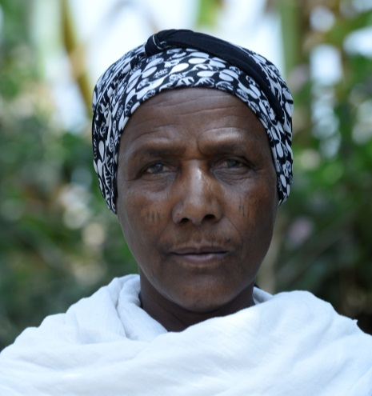
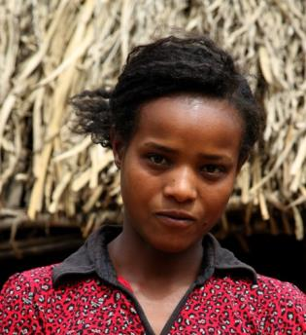
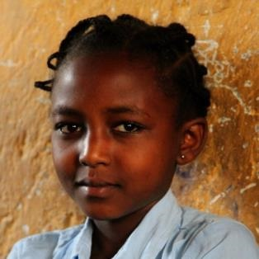
Pregnancy and Childbearing
Asegedech and Abebe now have five children: two daughters and three sons.
She gave birth to four of her children at home.
Asegedech was pregnant seven times but she had one miscarriage and lost one child as an infant.
She gave birth to her last child at the nearest health center and started using family planning.
Photos by Michael Tewelde
3

Slide 4
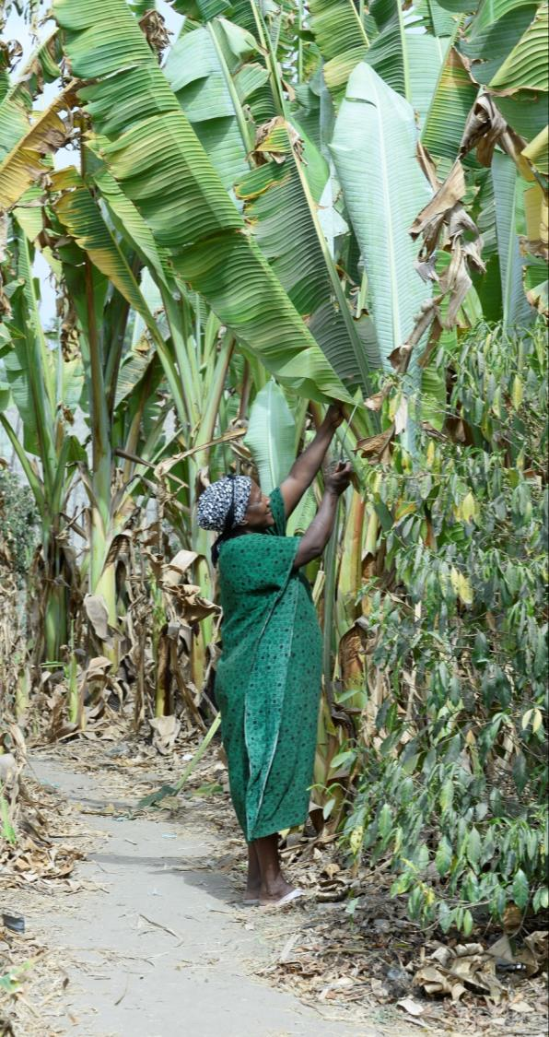
Daily Life
Asegedech spends her day caring for the children and doing household chores.
She is also involved in petty trading of vegetables.
Her husband Abebe is a farmer. He sells his products for a small profit.
Asegedech never had the opportunity to go to school.
Photo by Michael Tewelde
4

Slide 5
Family Decisions
Asegedech does not participate in major household decisions except those related to visiting her relatives.
Abebe makes all of the decisions, such as when to take the children to a health facility or how to spend family money.
Abebe beats Asegedech if she challenges his decisions, and she accepts it.
Domestic violence is considered a private matter—not to be talked about outside the family—so Asegedech is forced to remain quiet.
Photo by Michael Tewelde
5

Slide 6
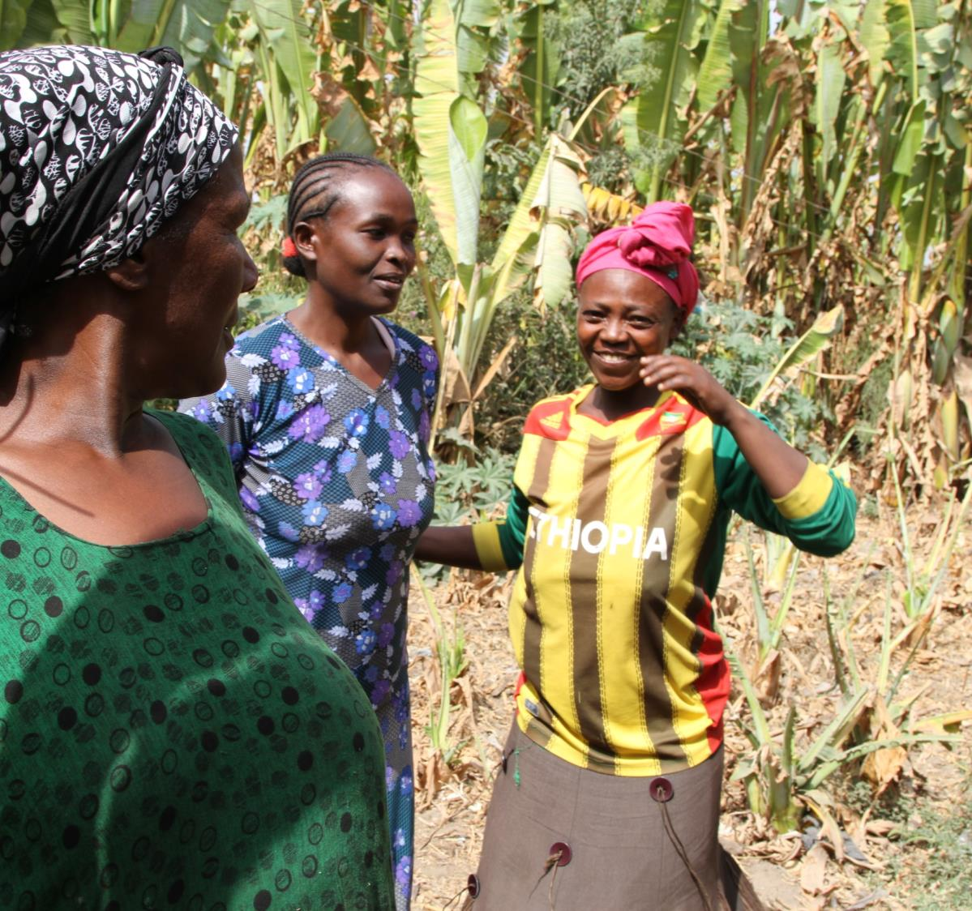
Asegedech is not different from other women her age in rural Ethiopia.
Photo by Michael Tewelde
6

Slide 7
Marriage and Childbearing
Ethiopian women:
Marry before age 17 and have their first sexual encounter at the same age
Have their first child by age 19
Half of non-first births in Ethiopia occur less than three years apart.
On average, rural women in Ethiopia give birth to five children.

Slide 8
Maternal, Infant, and Child Mortality
Maternal mortality accounts for 30% of all deaths among women ages 15–49.
In Ethiopia, three mothers die every two hours (13,000 women per year) due to complications from pregnancy or childbirth.
One in every 23 infants dies before her/his first birthday.
One in every 15 children dies before her/his fifth birthday.
Notes:
High risk births lead to high maternal mortality rates.
In Ethiopia, we have seen a decrease in maternal mortality rates over the past decade. however, approximately 2 women or girls dies every 2 hours due to complications from pregnancy or childbirth
Note: Out of 100,000 live births, 420 women and girls die due to complications from pregnancy or childbirth (World Bank). 13,000 women and girls die every year due to complications from pregnancy or childbirth (UNFPA).
Source UNFPA; DHS 2011

Slide 9
Family Planning Use
Two in every five married women use family planning—mostly modern methods.
One in five married women who want to space their births or have no more children are not using family planning.
Notes:
Mini DHS 2014

Slide 10
Girls’ Education
Seven out of 10 women cannot read and write.
More than eight out of 10 school-age girls enroll in primary education but only half of them complete this level.
Only one in four girls proceed to the secondary education level.
Photo by Michael Tewelde
Notes:
Data source: MOE Annual education statistical abstract (2012/13); UNESCO institute for statistics

Slide 11
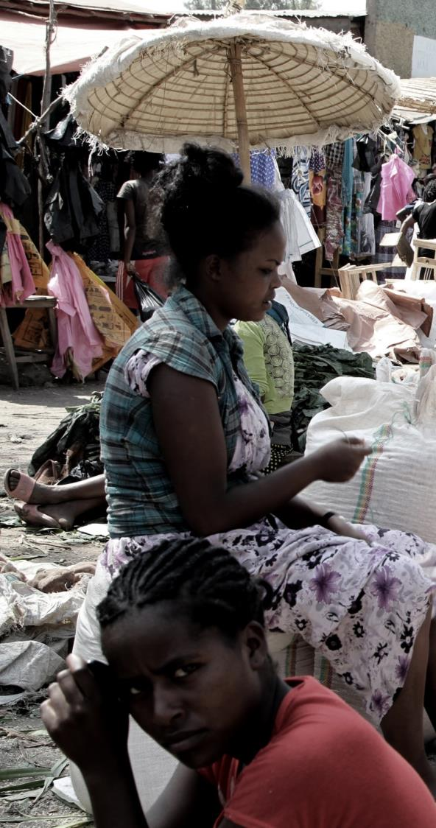
Economic Participation
Four out of 10 women ages 15–49 were employed in 2011.
Almost half of the women employed work in the agricultural sector, while one-third are engaged in sales and services.
Photo by Michael Tewelde
Notes:
DHS 2011

Slide 12
Decision-making Power
Six out of 10 married women make decisions with their husbands concerning important purchases for their families.
Only one out of five married women make autonomous decisions regarding their health.
Notes:
DHS 2011

Slide 13
Violence Against Women
Domestic violence is common in Ethiopia.
Two women in every three believe that being beaten by one’s husband is acceptable.
The acceptance of wife beating decreases as the education level and wealth of women increases.
Half of married women are aware of the law against a husband beating his wife.
Notes:
DHS 2011

Slide 14
Female Genital Cutting
Seven out of 10 women have experienced some form of female genital cutting (FGC).
14
Notes:
DHS 2011

Slide 15
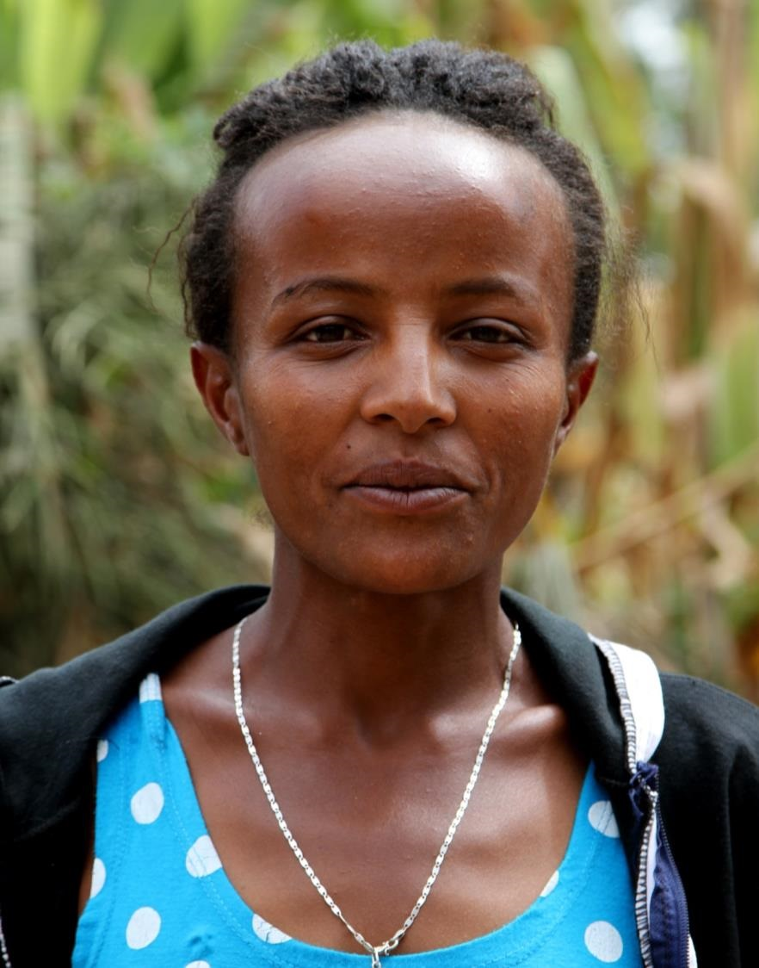
What if we could change conditions to improve the lives of women like Asegedech and their families?
Photo by Michael Tewelde
15
15

Slide 16
RAPIDWomen Model
Looks at future scenarios
based on current national data
Builds on the RAPID model,
which explores the impact of population growth on society
and development goals
Includes strategies focused on women’s empowerment
in support of national development
Family planning
Girls’ education
Equitable gender norms
16

Slide 17
Three Policy Scenarios
Base
Modest investments in family planning, girls’ education, and equitable gender norms
Family Planning
Emphasis
Increase investment in FP only to increase access to high-quality services
More women using appropriate method of FP for spacing and limiting child birth
Modest investment in girls’ education and equitable gender norms
Family Planning +
Women’s
Empowerment
Increase investment in family planning
Education attains benchmark of Kenya (lower-middle-income country)
Gender norms, which are measured by acceptance of wife beating, attain current level of urban Ethiopia
17

Slide 18
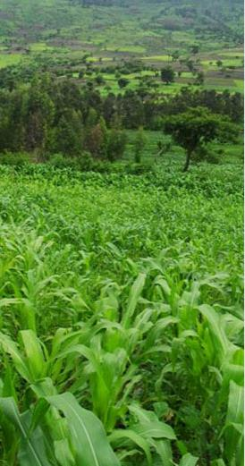
Results:
Improvements in gender norms, girls’ education, and family planning benefit Ethiopian women, their families, and the country.
Photo by ILRI/Lamond from Bangor University
18

Slide 19
Mothers’ Lives Saved cumulative
By 2035
154,000
FP+ Women Empowerment
51,000
FP Emphasis
19

Slide 20
Infants’ Lives Saved cumulative
By 2035
0.6 million
FP Emphasis
1.5 million
FP+ Women Empowerment
20

Slide 21
Children’s Lives Saved cumulative
By 2035
1 million
FP Emphasis
2.6 million
FP+ Women Empowerment
21

Slide 22
Family Planning Use
Achieve 54% CPR (National target)
2027
2019
FP Emphasis
FP+ Women Empowerment
22

Slide 23
Average Number of Children Total Fertility Rate
By 2035
2.5
2.0
Children per woman
FP Emphasis
Children per woman
FP+ Women Empowerment
23

Slide 24
Population Size Total Population
By 2035
136
120
Total population, millions
FP Emphasis
Total population, millions
FP+ Women Empowerment
24

Slide 25
What can we do now to bring about these improvements?
Photo by Michael Tewelde
25

Slide 26
Family Planning Actions
Improve the family planning service quality in terms of accessibility and comprehensiveness.
Integrate family planning with other maternal and child health services.
Scale up family planning services in regions with low contraceptive prevalence (pastoralist and emerging regions).
Increase domestic funding for family planning.
26

Slide 27
Family Planning Actions
Incorporate sexual education in school curricula.
Educate women to use the most appropriate FP method based on their need to space or limit births.
Engage influential people (e.g., religious leaders, opinion leaders) in promoting family planning.
Give focus to male engagement in supporting reproductive health service utilization.
Address unmet need among married adolescent girls (ages 15–19).
27

Slide 28
Girls’ Education Actions
Raise awareness among parents on the advantages of educating their daughters.
Make the school environment convenient for girls.
Support girls in school to succeed in completing their education.
Make secondary schools accessible (geographically).
Design a plan to engage educated girls in a productive activity.
Expand literacy programs for women and girls who are not in school.

Slide 29
Gender Norms Actions
Improve women’s knowledge about the national family law.
Reinforce the implementation of laws related to gender-based violence and harmful traditional practices.
Increase couples’ communication and promote gender equality norms to reduce physical, sexual, and emotional violence against women.
Educate the community about the advantages of women’s engagement in economic activities.
Support women to engage in income-generating activities by accessing credit through small scale and micro-enterprises.
Incorporate gender education in school curricula.

Slide 30
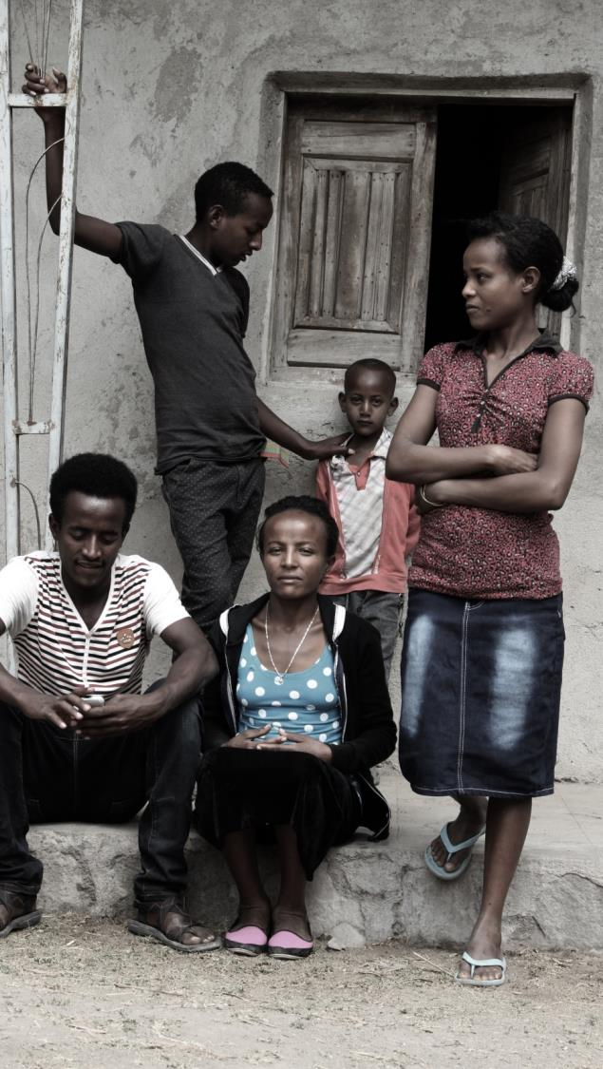
What do these changes mean for Asegedech and her family?
Photo by Michael Tewelde
30

Slide 31
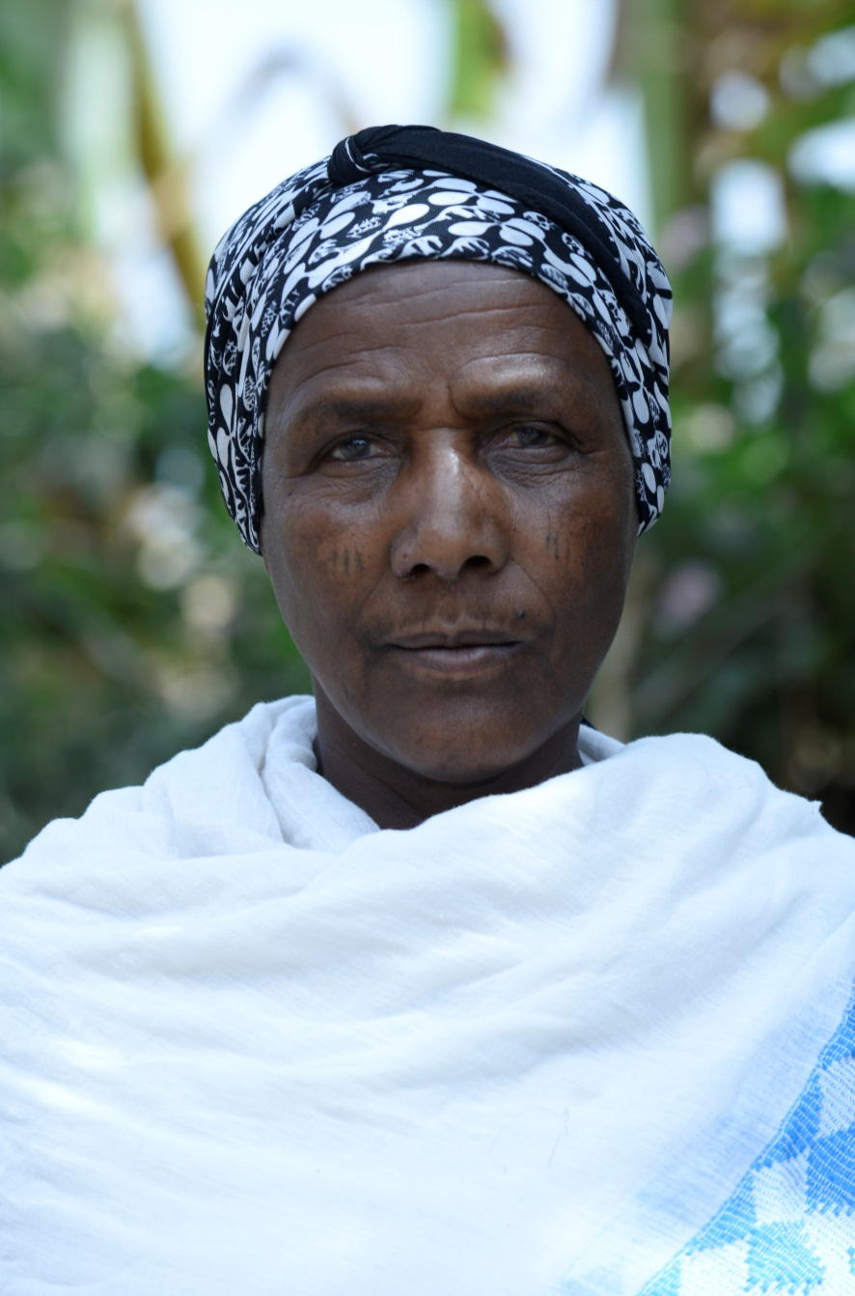
Asegedech
Communication becomes more frequent between Asegedech and Abebe.
Abebe stops using physical violence against her.
Asegedech starts going to literacy class and participates in a small savings group in the village.
She and Abebe decide to stop having children, and she starts using an appropriate FP method.
Their children attend school and go to the health center when needed.
Photo by Michael Tewelde

Slide 32
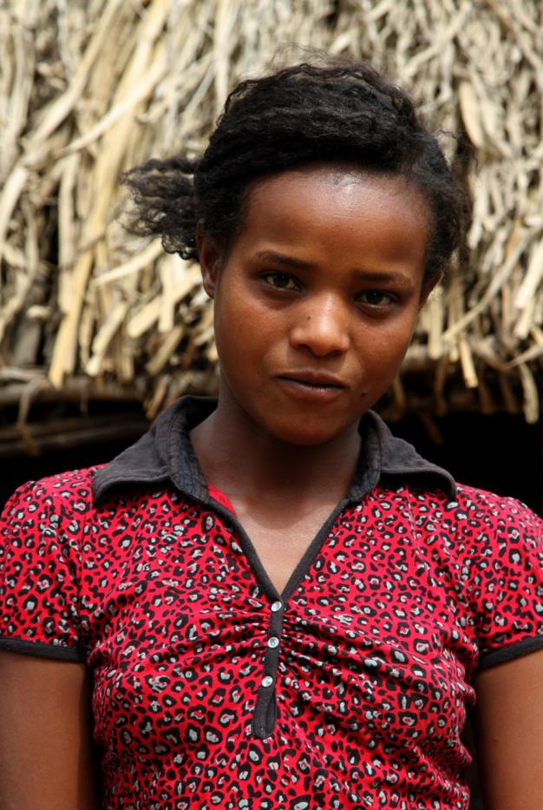
Photo by Ellen Smith
Alem
Alem, Asegedech’s first daughter, completes secondary education.
She starts her own small poultry business in a nearby town by accessing money from a savings and credit association.
She is circumcised at a young age.
She marries a man she met in the town at age 18.
At age 20, she has her first child.
She hopes to have three children, and she uses family planning to space her pregnancies.
Photo by Michael Tewelde

Slide 33
Addis
Addis, Alem’s daughter and Asegedech’s granddaughter, completes university, studying business management.
She expands her mother’s business into a modern poultry farm.
As a young girl, she does not experience FGC.
At age 23, she marries a man of her choice and has her first child at age 24.
She hopes to have two children and plans to wait three years between pregnancies.
Photo by Michael Tewelde
33

Slide 34
Conclusion
Empowering women and girls through
…increasing investment in girls’ education,
…reducing gender-based violence,
…increasing couple communication and promoting gender equality, and
…increasing domestic funding in family planning
will help reduce maternal, infant, and child mortality and improve the health and well-being of Ethiopian women and their families.

Slide 35
Funding provided by:
The Health Policy Project is a five-year cooperative agreement funded by the U.S. Agency for International Development under Agreement No. AID-OAA-A-10-00067, beginning September 30, 2010. It is implemented by Futures Group, in collaboration with Plan International USA, Avenir Health (formerly Futures Institute), Partners in Population and Development, Africa Regional Office (PPD ARO), Population Reference Bureau (PRB), RTI International, and the White Ribbon Alliance for Safe Motherhood (WRA).
The information provided in this presentation is not official U.S. Government information and does not necessarily represent the views or positions of the U.S. Agency for International Development.

