Slide 2
USG Policies,
Non-Discrimination, and Gender Norms

Slide 3
Today’s Agenda
Morning | Introduction
 | Break
Late morning | Concepts and terminology
 | Lunch
Afternoon | Local advocates panel
Late afternoon | Meaningful engagement
3

Slide 4
A Global Training
4

Slide 5
Please don’t forget…
The U.S. Constitution protects against religious discrimination.
We will never ask you to change your religious or personal beliefs.
We will also never ask you to tell us your sexual orientation.
5

Slide 6
Who are gender and sexual minorities (GSMs)?
People whose gender, sexual orientation, or biological sex characteristics differ from what is typically expected by a culture or society.
6

Slide 7
Who are gender and sexual minorities (GSMs)?
All people
GSM
LGBT
7

Slide 8
What Will You Learn Today?
Key gender and sexual orientation concepts and terminology
What gender and sexual orientation mean for your professional role
  In the workplace (non-discrimination)
  In programs (meaningful engagement)
8

Slide 9
Why Is This Training Important?
Reaching GSMs with HIV services that are sensitive to their unique needs is crucial to the global HIV response.
Gender and sexual orientation are important concepts to understand and a shared language to discuss it is essential.
Engaging with GSM communities matters, but how you engage matters even more.
9

Slide 10


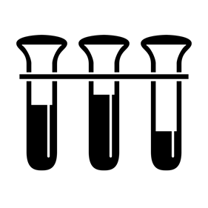
#1
Stigma and discrimination impacts HIV and health
AFRICA
Among men who have sex with men (MSM) in Swaziland, stigma and discrimination impacted seeking healthcare and disclosing same-sex sexual practices to healthcare providers (Risher et al., 2013).
18% of MSM in Malawi and Namibia and 21% of MSM in Botswana felt afraid to seek health services (Beyrer, 2010).
HIV-related stigma has been found to be a barrier to HIV testing among MSM and transgender women (Golub and Garamel, 2013).
10a

Slide 11
#1
Stigma and discrimination impacts HIV and health
ASIA-PACIFIC
In urban and rural Vietnam, homophobic stigma was found to increase risk taking behaviors, including the type and number of sexual partners (Ha et al., 2014).
HIV-related stigma was found to be a barrier to pre-exposure prophylaxis medication adherence among men who have sex with men (MSM) in Chiang Mai, Thailand (Tangmunkongvorakul et al., 2013).
HIV-related stigma was found to be a reason for never having been tested for HIV among 28% of young, migrant MSM in China (Song et al., 2011).
10b

Slide 12
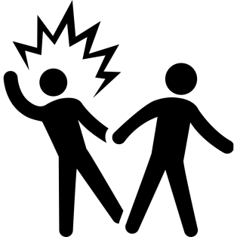
#1
Stigma and discrimination impacts HIV and health
LAC
Health workers surveyed in Barbados reported that stigma is a critical barrier to disclosure and service uptake by men who have sex with men (MSM) (Maiorana et al., 2013).
Among MSM in Jamaica, those who had been victims of physical violence were found to be twice as likely to be living with HIV (Figueroa et al., 2013).
Internalized sexual minority stigma was negatively associated with ever being tested for HIV among MSM in El Salvador (Andrinopoulos et al., 2014).
10c

Slide 13
#2
Overall, MSM are 19 times as likely to be living with HIV
Source: Beyrer, 2011
11

Slide 14
#3
Overall, transgender women are 49 times as likely to be living with HIV
Source: Baral, et al., 2013
12

Slide 15
#4
HIV prevention dollars fail to adequately reach MSM
Source: National AIDS Spending Assessments and compiled modes of transmission data, latest available
13

Slide 16
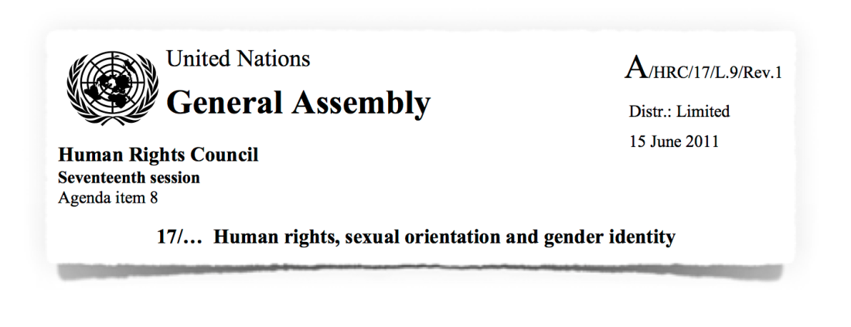
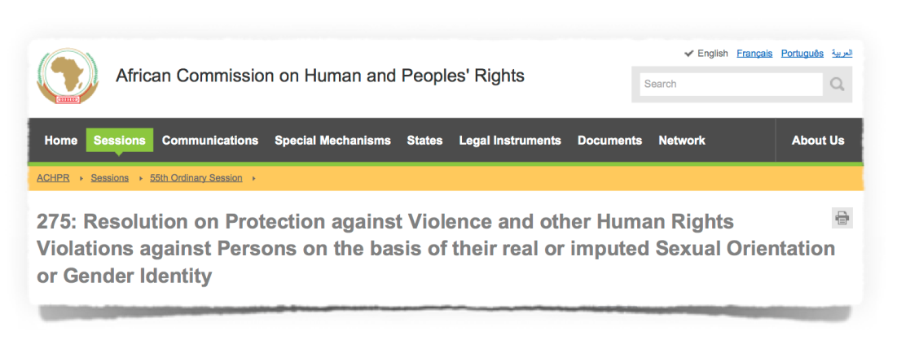
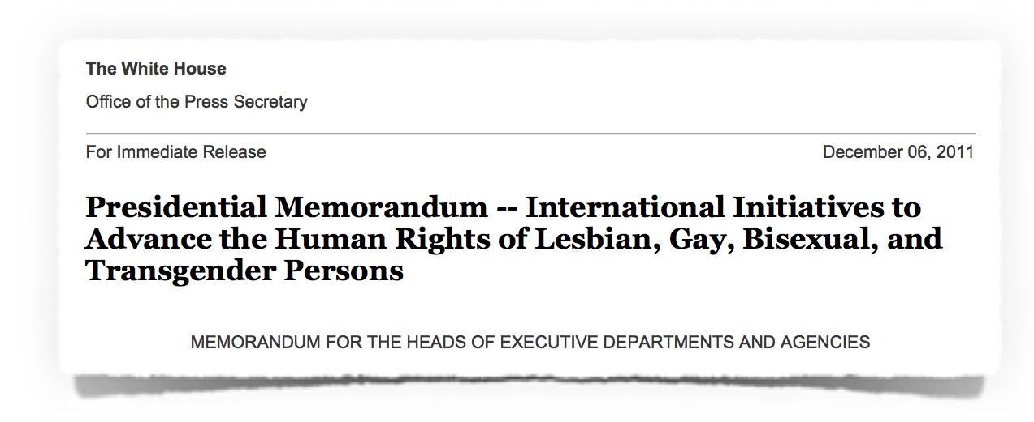
#5
International recognition of the human rights of GSMs is growing
AFRICA
14a

Slide 17
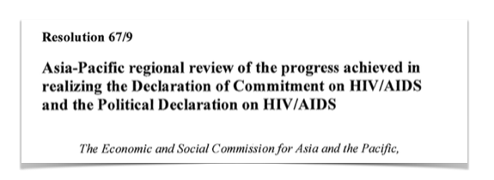
#5
International recognition of the human rights of GSMs is growing
ASIA-PACIFIC
14b

Slide 18
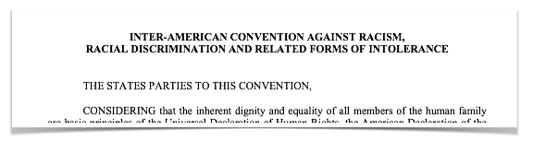
#5
International recognition of the human rights of GSMs is growing
LAC
14c

Slide 19
So What?
GSM-related stigma and discrimination impacts health and worsens the elevated HIV risk faced by MSM and transgender women.
Despite being a significant part of most HIV epidemics around the world, GSMs receive inadequate HIV resources.
Support for the human rights of GSMs is growing but much remains to be done.
PEPFAR and its partners are uniquely positioned to make an impact and the right time to act is now.
15

Slide 20
Discriminating against someone at work because of one’s real or perceived sexual orientation or gender identity is prohibited
Executive Order 11478 bars discrimination against federal employees on the basis of race, color, religion, sex, national origin, disability, age, status as a parent, sexual orientation, or gender identity.
  President Clinton added sexual orientation to the list in May 1998, and President Obama added gender identity in July 2014.
16

Slide 21
For More Information
The Department of State’s Equal Employment Opportunity regulations are located at 3 Foreign Affairs Manual 1500, which are currently being revised in light of the President’s most recent Executive Order.
17

Slide 22
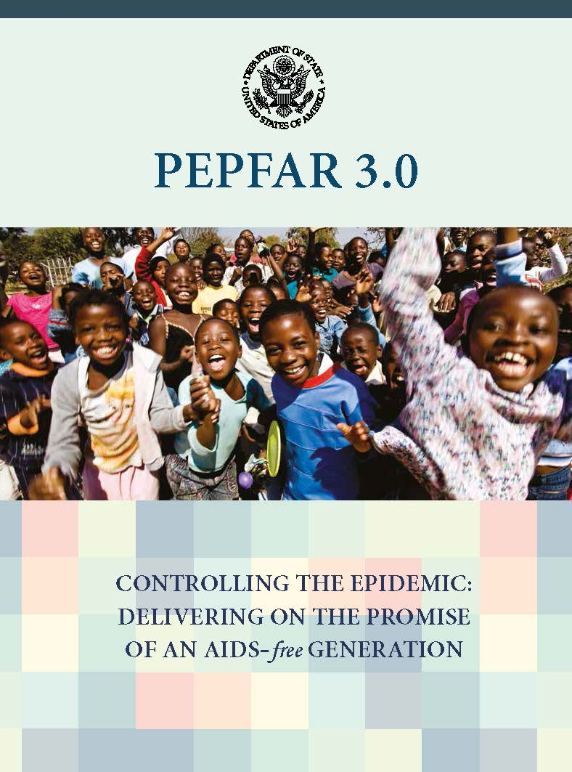
PEPFAR 3.0
  Gender and sexual minorities, and especially MSM and transgender people, are an important part of PEPFAR 3.0’s Impact Action Agenda, Partnership Action Agenda, and Human Rights Action Agenda.
18

Slide 23
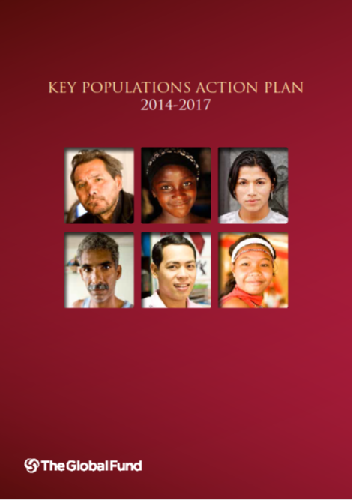
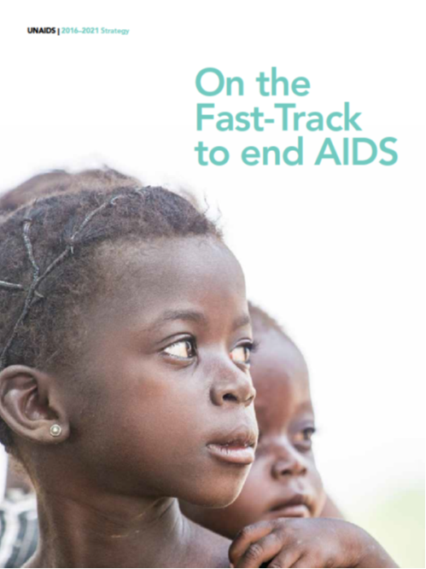
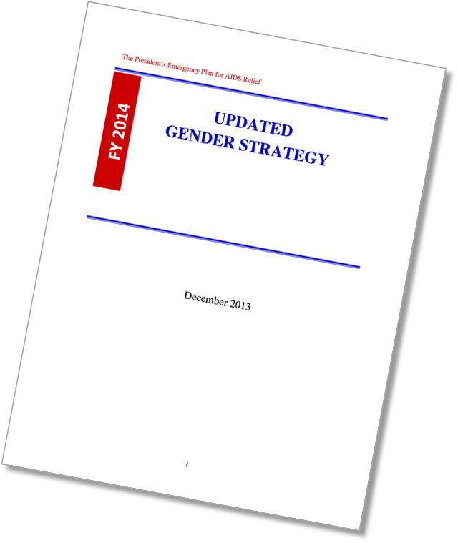
UNAIDS 2016-2021 Strategy
The Global Fund
Key Populations Strategy 2014-2017
PEPFAR 3.0
PEPFAR Updated Gender Strategy
19

Slide 24
Why is integrating gender important?
Gender norms and inequalities, and gender-based violence (GBV), affect health outcomes for all people.
Enjoying the highest attainable standard of health is a human right.
Understanding the unique needs and vulnerabilities of all people helps identify target populations, tailor responses, and dedicate resources where they are most needed.
20

Slide 25
A Framework for Results
The Updated Gender Strategy
Details the relationship between gender inequality, GBV, and HIV
Is based upon a two-pronged approach to gender integration;
Is built around a detailed results framework
Details the who, what, why, and how of integrating gender into HIV programs
21

Slide 26
New Requirements
An interagency gender analysis is required by March 2016
Monitoring, evaluation and reporting indicators and Site Improvement through Monitoring System core essential elements domains on gender equality and GBV are aligned and reinforce each other
Teams are encouraged to use the gender equality or GBV cross cutting budget attributions
22

Slide 27
Gender Norms and Health
23

Slide 28
It bothers me when I see a man act like a woman.
Strongly Agree
Agree
Neutral
Disagree
Strongly Disagree
24

Slide 29
Under some circumstances, it’s okay for a man to discipline his wife.
Strongly Agree
Agree
Neutral
Disagree
Strongly Disagree
25

Slide 30
I prefer my supervisor to be a man.
Strongly Agree
Agree
Neutral
Disagree
Strongly Disagree
26

Slide 31
Under some circumstances, it’s okay for a wife to discipline her husband.
Strongly Agree
Agree
Neutral
Disagree
Strongly Disagree
27

Slide 32
Key Takeaways
The USG prohibits discrimination based on sexual orientation and gender.
An AIDS-free generation is impossible without reaching gender and sexual minorities.
Gender norms are a powerful influence in the health and lives of all of us.
The PEPFAR Updated Gender Strategy helps us account for the effect that gender norms have on populations who need services.
28

Slide 33
CONCEPTS and TERMINOLOGY on GSD

Slide 34
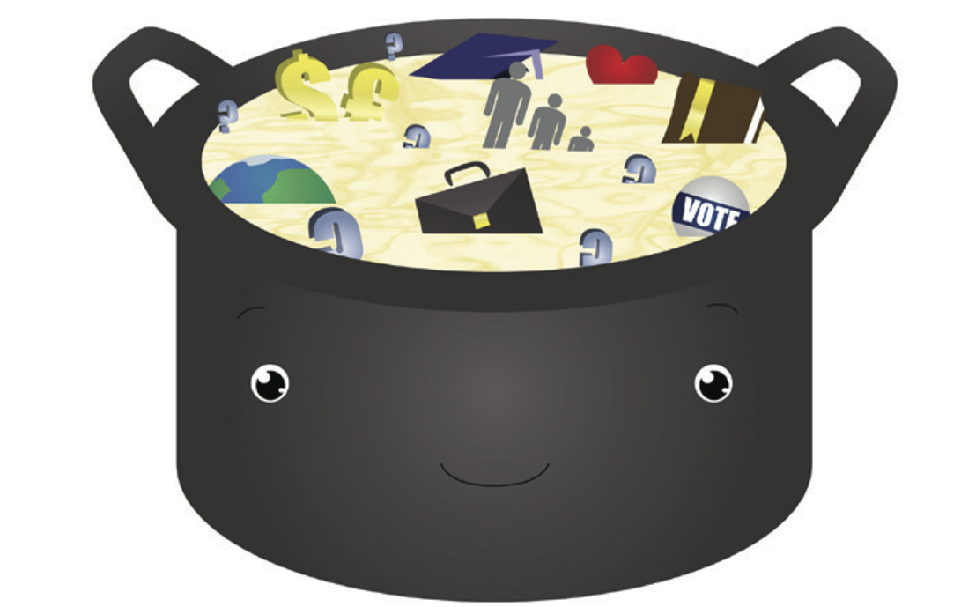
BASE AND BROTH | EARLY ADDITIONS | OPTIONAL | SECRET INGREDIENTS
Ethnicity | Socioeconomic Status | Hobbies and Passions | Personal Experiences
Gender | Geographic Location | Religion and Faith | Hidden Experiences
Sexual Orientation | Education | Career
Disability Status | Family Structure | Political Beliefs
Adapted from: Killerman, 2013
30

Slide 35
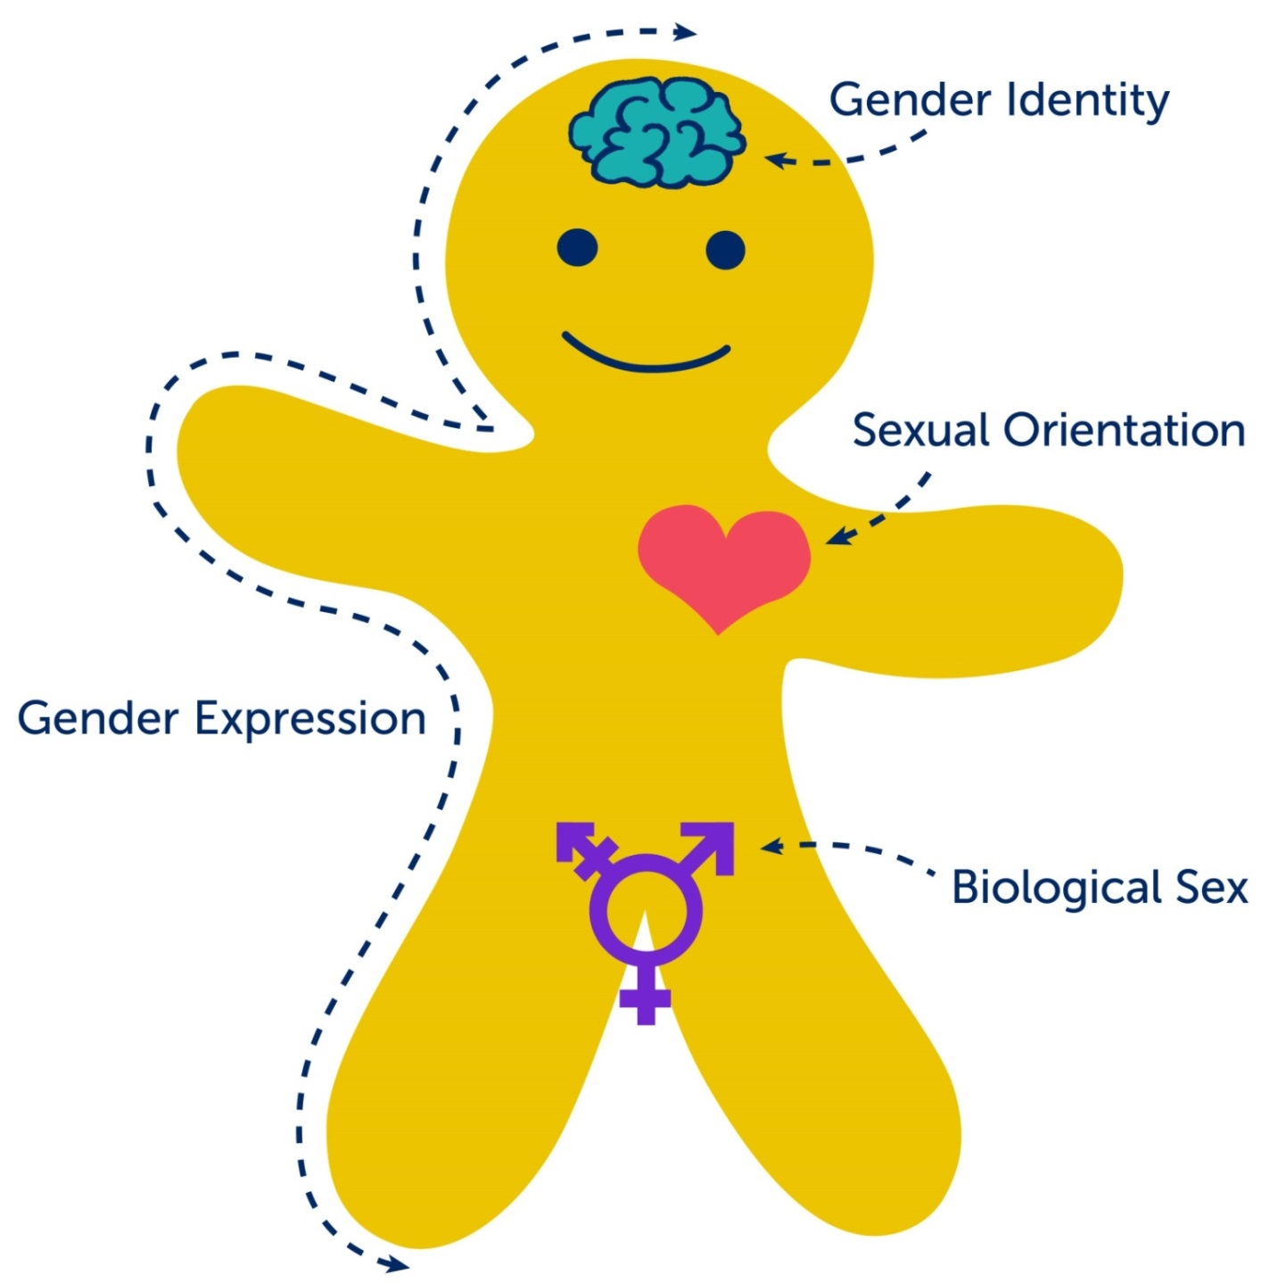
Adapted from: Killerman, 2013
31

Slide 36
Which of the following is the meaning of biological sex?
A medical term used to refer to the chromosomal, hormonal, and anatomical characteristics that are used to classify an individual as female or male or intersex.
An enduring emotional, romantic, or sexual attraction primarily or exclusively to people of a particular gender.
A person’s deeply felt internal and individual experience of gender, which may or may not correspond with the sex assigned at birth.
The external display of one’s gender, through a combination of appearance, disposition, social behavior, and other factors, generally measured on a scale of masculinity and femininity.
32

Slide 37
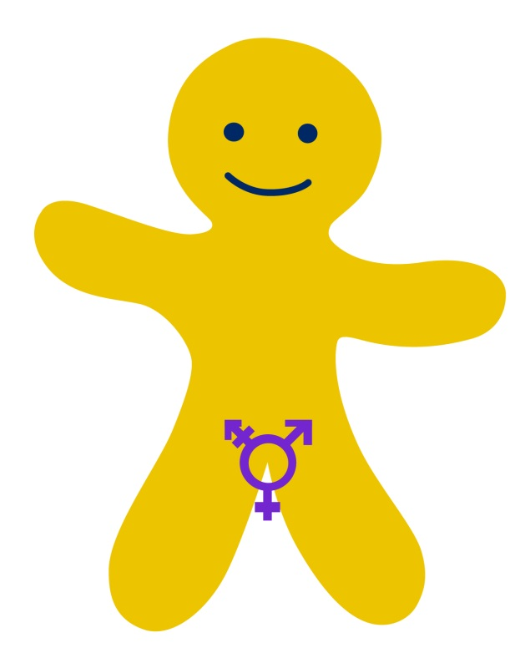
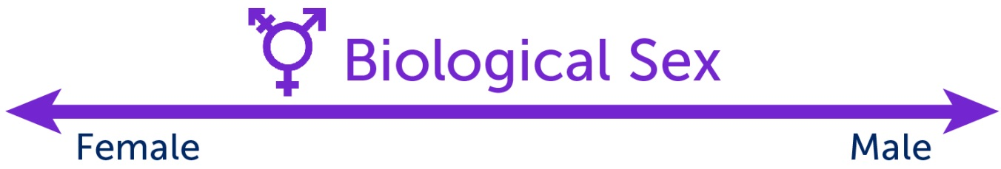
Biological Sex
A medical term used to refer to the chromosomal, hormonal, and anatomical characteristics that are used to classify an individual as female, male or intersex.
Intersex: An umbrella term that refers to a variety of chromosomal, hormonal, and anatomical conditions in which a person does not seem to fit the typical definitions of female or male.
Adapted from: Killerman, 2013
33

Slide 38
Which of the following is the meaning of gender expression?
A medical term used to refer to the chromosomal, hormonal, and anatomical characteristics that are used to classify an individual as female or male or intersex.
An enduring emotional, romantic, or sexual attraction primarily or exclusively to people of a particular gender.
A person’s deeply felt internal and individual experience of gender, which may or may not correspond with the sex assigned at birth.
The external display of one’s gender, through a combination of appearance, disposition, social behavior, and other factors, generally measured on a scale of masculinity and femininity.
34

Slide 39
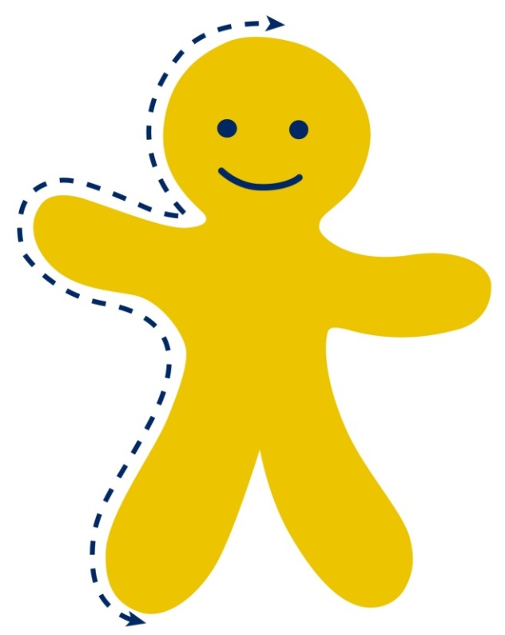
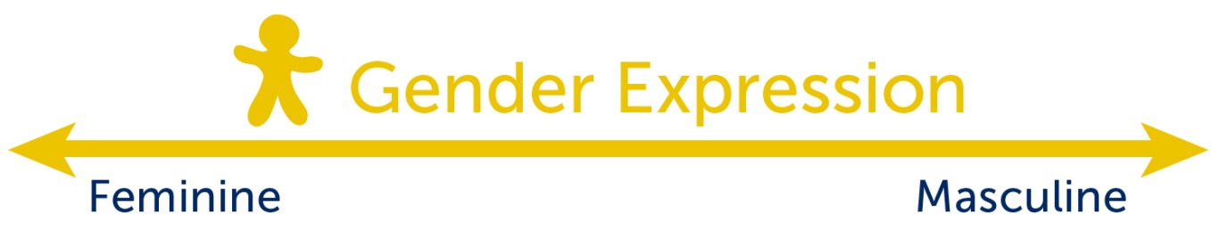
Gender Expression
The external display of one’s gender, through a combination of appearance, disposition, social behavior, and other factors, generally measured on a scale of masculinity and femininity.
Gender norms: A culturally-defined set of roles, responsibilities, rights, entitlements, and obligations, associated with being female and male, as well as the power relations between and among women and men, boys and girls.
Adapted from: Killerman, 2013
35

Slide 40
Which of the following is the meaning of gender identity?
A medical term used to refer to the chromosomal, hormonal, and anatomical characteristics that are used to classify an individual as female or male or intersex.
An enduring emotional, romantic, or sexual attraction primarily or exclusively to people of a particular gender.
A person’s deeply felt internal and individual experience of gender, which may or may not correspond with the sex assigned at birth.
The external display of one’s gender, through a combination of appearance, disposition, social behavior, and other factors, generally measured on a scale of masculinity and femininity.
36

Slide 41
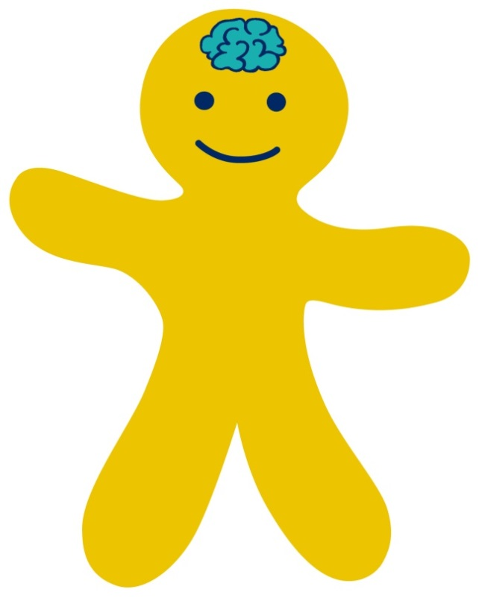
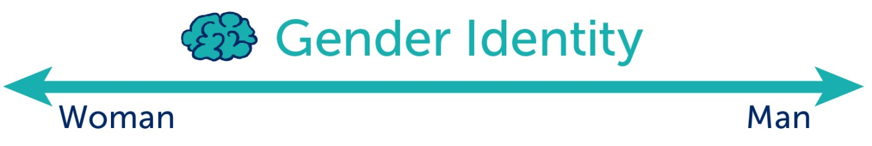
Gender Identity
A person’s deeply felt internal and individual experience of gender, which may or may not correspond with the sex assigned at birth.
Transgender: An umbrella term referring to an individual whose gender identity is different from their sex assigned at birth.
Adapted from: Killerman, 2013
37

Slide 42
Which of the following is the meaning of sexual orientation?
A medical term used to refer to the chromosomal, hormonal, and anatomical characteristics that are used to classify an individual as female or male or intersex.
An enduring emotional, romantic, or sexual attraction primarily or exclusively to people of a particular gender.
A person’s deeply felt internal and individual experience of gender, which may or may not correspond with the sex assigned at birth.
The external display of one’s gender, through a combination of appearance, disposition, social behavior, and other factors, generally measured on a scale of masculinity and femininity.
38

Slide 43
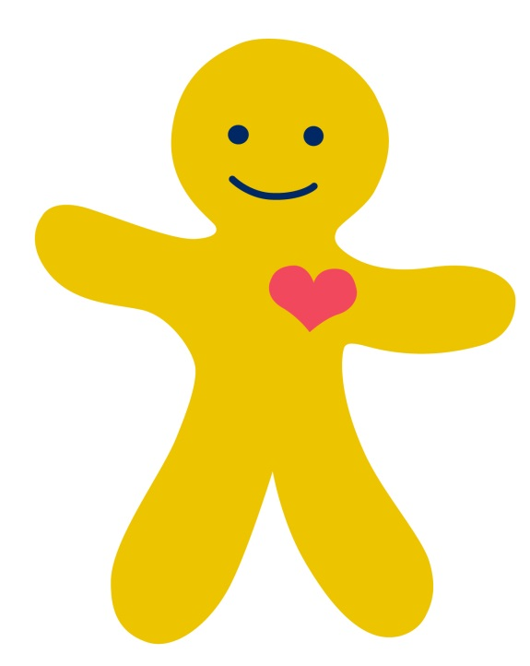
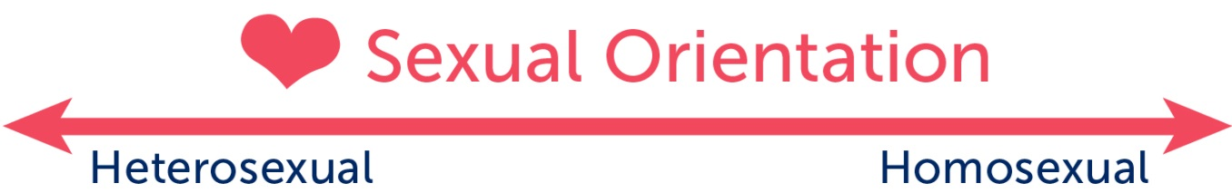
Sexual Orientation
An enduring emotional, romantic, or sexual attraction primarily or exclusively to people of a particular gender.
Heterosexuality: An enduring emotional, romantic, or sexual attraction primarily or exclusively to people of a different gender. People who are heterosexual often identify as “straight.”
Homosexuality: An enduring emotional, romantic, or sexual attraction primarily or exclusively to people of the same gender. People who are homosexual often identify as “gay” or “lesbian.”
Adapted from: Killerman, 2013
39

Slide 44
Sexual Orientation
An enduring emotional, romantic, or sexual attraction primarily or exclusively to people of a particular gender.
Bisexuality: An enduring emotional, romantic, or sexual attraction to people of more than one gender. People who are bisexual often identify as “bisexual.”
Asexuality: An enduring absence of sexual attraction. People who are asexual often identify as “asexual.”
Adapted from: Killerman, 2013
40

Slide 45
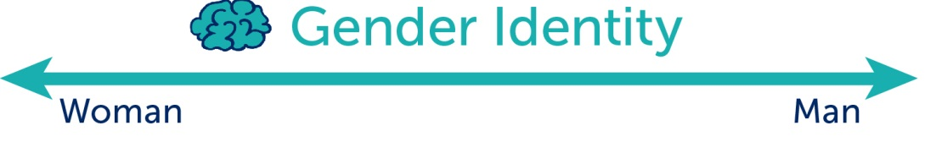
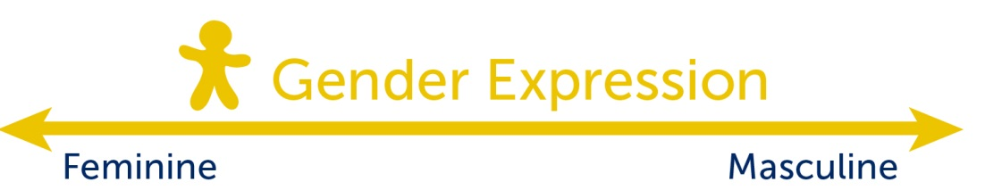
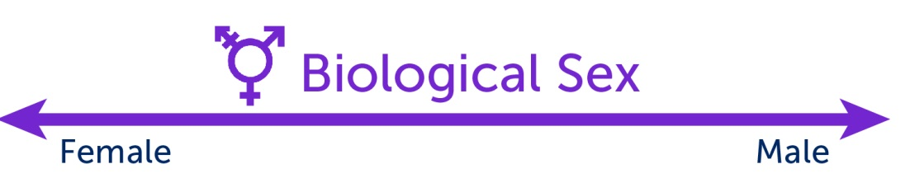
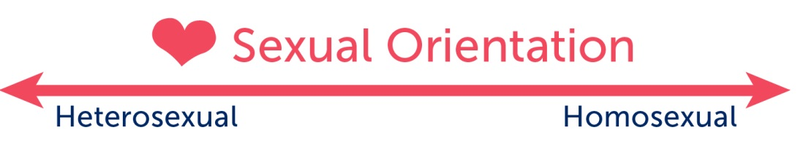
Adapted from: Killerman, 2013
41

Slide 46
Adapted from: Killerman, 2013
42

Slide 47
Adapted from: Killerman, 2013
43

Slide 48
Adapted from: Killerman, 2013
44

Slide 49
Additional Terminology
MSM | Men who have sex with men. Men may be considered MSM if they engage in sex with other men, regardless of whether or not they identify as gay or bisexual.
LGBT | Lesbian, gay, bisexual, transgender. This acronym is commonly used to refer to gender and sexual minority communities. Variations exist that add, omit or reorder letters (e.g., LGBTI, LGB, GLBT).
GSM | The majority of the world’s population is presumed heterosexual and male or female. Gender and sexual minorities are everyone else, people whose gender, sexual orientation, or sexual characteristics are different.
45

Slide 50
Additional Terminology
Homophobia Transphobia | The fear, rejection, or aversion, often in the form of stigmatizing attitudes or discriminatory behavior, towards homosexuality or transgenderism.
Heteronormativity | The presumption that everyone is heterosexual or the belief that heterosexual people are naturally superior to gender and sexual minorities.
Sexism | Prejudice or discrimination based on a person’s sex or gender. Sexist attitudes may stem from traditional stereotypes of gender roles and may include the belief that a person of one sex is naturally superior to a person of another.
46

Slide 51
Additional Terminology
Closeted | The state of secrecy or cautious privacy regarding one’s sexual orientation or gender identity (also referred to as being “in the closet”).
Coming out | The personal process of accepting and disclosing to others that one is lesbian, gay, bisexual, or transgender.
Outing | Telling people (e.g., through gossip) that someone else is LGBT or a gender or sexual minority without that person’s permission, no matter the intention.
Ally | A person who openly supports the equal treatment and human rights of gender and sexual minorities.
47

Slide 52
Local Terminology
What are some terms used to describe gender and sexual minorities in your country or culture?
48

Slide 53
Myths and Misconceptions
In your small groups, pick someone to read aloud the character study.
Discuss whether or not the character experienced discrimination.
Discuss the appropriate course of action and the best way you could offer support to the character if you were their colleague.
49

Slide 54
Key Takeaways
Everyone has a biological sex, gender expression, gender identity, and sexual orientation. Each of these exists on a continuum and varies from person to person.
It is important to understand key terms and concepts related to GSM and use respectful language in the workplace and programs.
Be cognizant of common myths regarding GSM and be ready to support our colleagues.
50

Slide 55
LOCAL ADVOCATES’ PANEL

Slide 56
Panelists
Panelist A, Organization
Email address
Panelist B, Organization
Email address
Panelist C, Organization
Email address
52

Slide 57
MEANINGFUL ENGAGEMENT

Slide 58
“Nothing about us without us.”
What are the key benefits of meaningful engagement? Why is it important?
What are the key challenges of meaningful engagement? Why is it not always easy?
54

Slide 59
What kinds of activities are opportunities for meaningful engagement?
Examples include…
Involvement in situational assessments
Consultation on operational plans and priorities
Involvement throughout all phases of programming, including research
Engagement in advocacy and policy dialogues with national, regional, and global stakeholders
Involvement in response to hostile events
55

Slide 60
Your Small Group Assignment
Draw a program cycle
Show THREE opportunities in that cycle for meaningful engagement
Where does at least ONE of you appear on it?
Note AT LEAST ONE next step
56

Slide 61
Meaningful Engagement of GSM Across the Program Cycle
Program Cycle (Illustrative)
Monitoring
Strategic Planning
Program Design
Imple-mentation
Evaluation
Work Planning
57

Slide 62
References
Andrinopoulos, K., J. Hembling, M. E. Guardado, F. de Maria Hernández, A. I. Nieto, et, al. 2014. "Evidence of the Negative Effect of Sexual Minority Stigma on HIV Testing among MSM and Transgender Women in San Salvador, El Salvador." AIDS and Behavior, 19(1): 60-71.
Baral, S. D., T. Poteat, S. Strömdahl, A. L. Wirtz, T. E. Guadamuz, and C. Beyrer. 2013. "Worldwide Burden of HIV in Transgender Women: A Systematic Review and Meta-analysis." The Lancet Infectious Diseases, 13(3): 214-222.
Beyrer, C., S. D. Baral, F. van Griensven, S. M. Goodreau, S. Chariyalertsak, et, al. 2012. "Global Epidemiology of HIV Infection in Men Who Have Sex with Men." The Lancet, 380(9839): 367-377.
Fay, H., S. D. Baral, G. Trapence, F. Motimedi, E. Umar, et, al. 2011. "Stigma, Health Care Access, and HIV Knowledge Among Men Who Have Sex with Men in Malawi, Namibia, and Botswana." AIDS and Behavior, 15(6): 1088-1097.
Figueroa, J., S. Weir, C. Jones-Cooper, L. Byfield, M. Hobbs, et, al. 2013. "High HIV Prevalence among MSM in Jamaica is Associated with Social Vulnerability and Other Sexually Transmitted Infections." The West Indian Medical Journal, 62(4): 286.
Golub, S. A. and K. E. Gamarel. 2013. "The Impact of Anticipated HIV Stigma on Delays in HIV Testing Behaviors: Findings from a Community-based Sample of Men Who Have Sex with Men and Transgender Women in New York City." AIDS Patient Care and STDs, 27(11): 621-627.
Ha, H. X., M. Ross, J. M. Risser, and H. T. Nguyen. 2014. "Determinants of Homosexuality-Related Stigma Among Men Who Have Sex with Men in Hanoi, Vietnam." International Journal of Sexual Health, 26(3): 200-216.
Killermann, S. 2013. The Social Justice Advocate’s Handbook: A Guide to Gender. Austin: Impetus Books.
Maiorana, A., G. Rebchook, N. Kassie, and J. J. Myers. 2013. "On Being Gay in Barbados: ‘Bullers’ and ‘Battyboys’ and Their HIV Risk in a Societal Context of Stigma." Journal of Homosexuality, 60(7): 984-1010.
Risher, K., D. Adams, B. Sithole, S. Ketende, C. Kennedy, et, al. 2013. "Sexual Stigma and Discrimination as Barriers to Seeking Appropriate Healthcare among Men Who Have Sex with Men in Swaziland." Journal of the International AIDS Society, 16(3Suppl 2).
Song, Y., X. Li, L. Zhang, X. Fang, X. Lin, et, al. 2011. "HIV-testing Behavior Among Young Migrant Men Who Have Sex with Men (MSM) in Beijing, China." AIDS Care, 23(2): 179-186.
Tangmunkongvorakul, A., S. Chariyalertsak, K. R. Amico, P. Saokhieo, V. Wannalak, et, al. 2013. "Facilitators and Barriers to Medication Adherence in an HIV Prevention Study among Men Who Have Sex with Men in the iPrEx Study in Chiang Mai, Thailand." AIDS Care, 25(8): 961-967.
58

